Slide 1
Group 2
Courtney, Lewis, Tom, and Heather

Slide 2
Game Footage

Slide 3
Feedback
Sounds
Visuals
Aesthetics

Slide 4
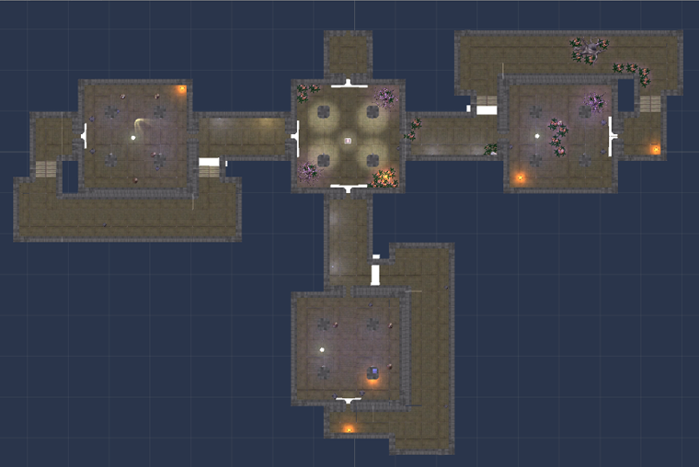
Level 01 Design
Using centre chamber and puzzle rooms as branches.
Japanese Okie principle in design.

Slide 5
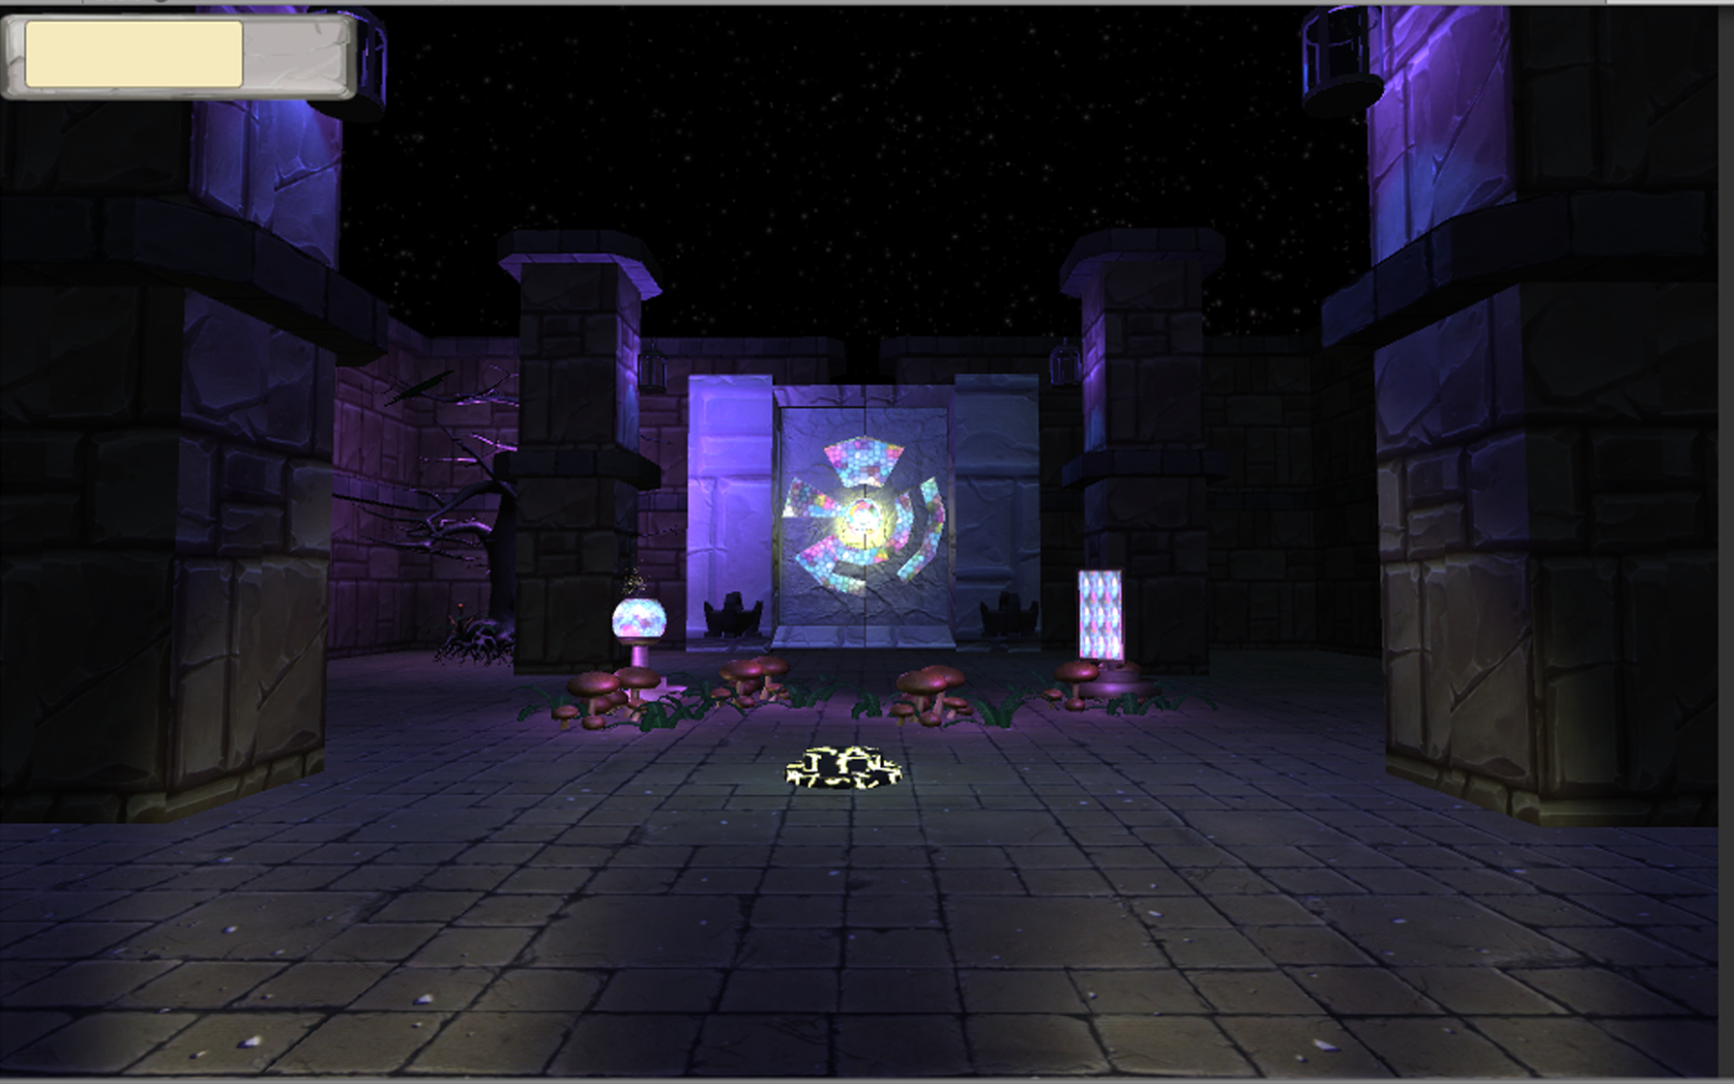
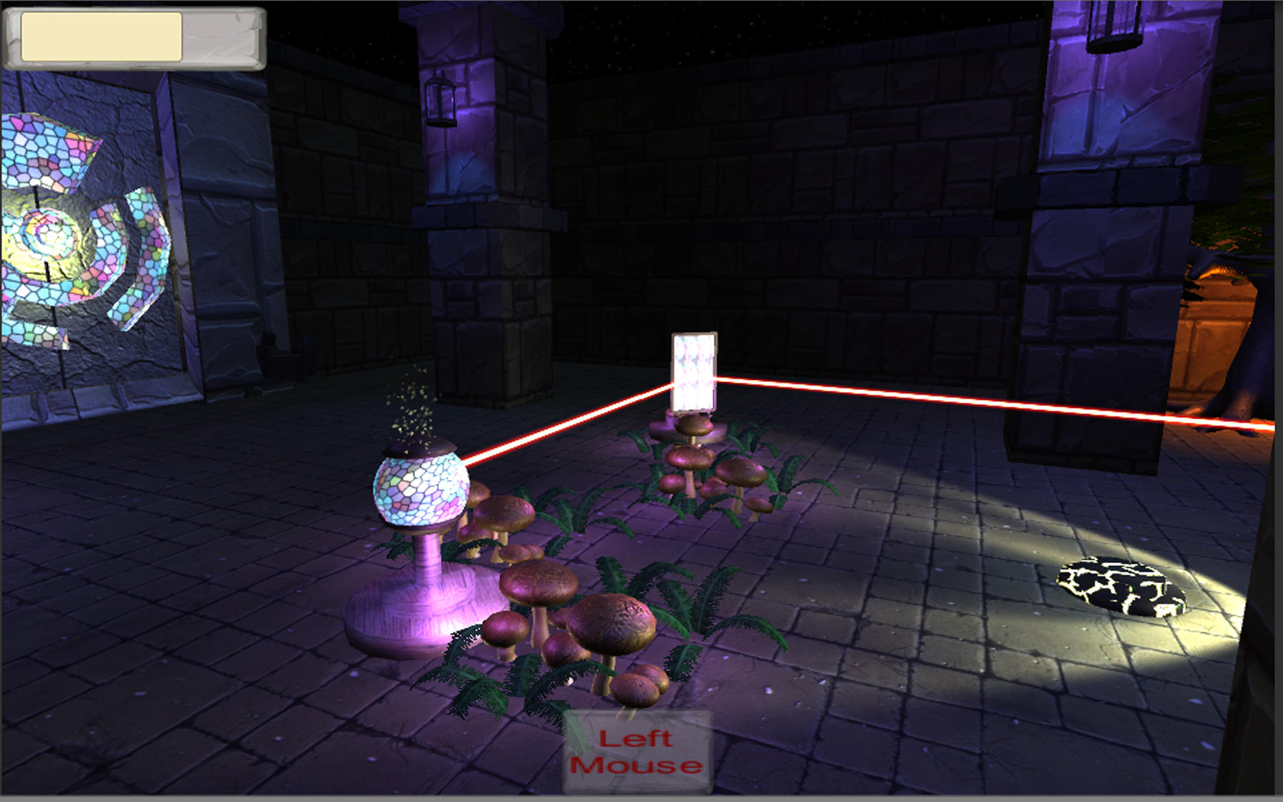
Level 01 Design
Puzzle follows a learn, practise master loop.
Teaching the player:
Rotating mirrors.
Health.
Lighting environment.

Slide 6
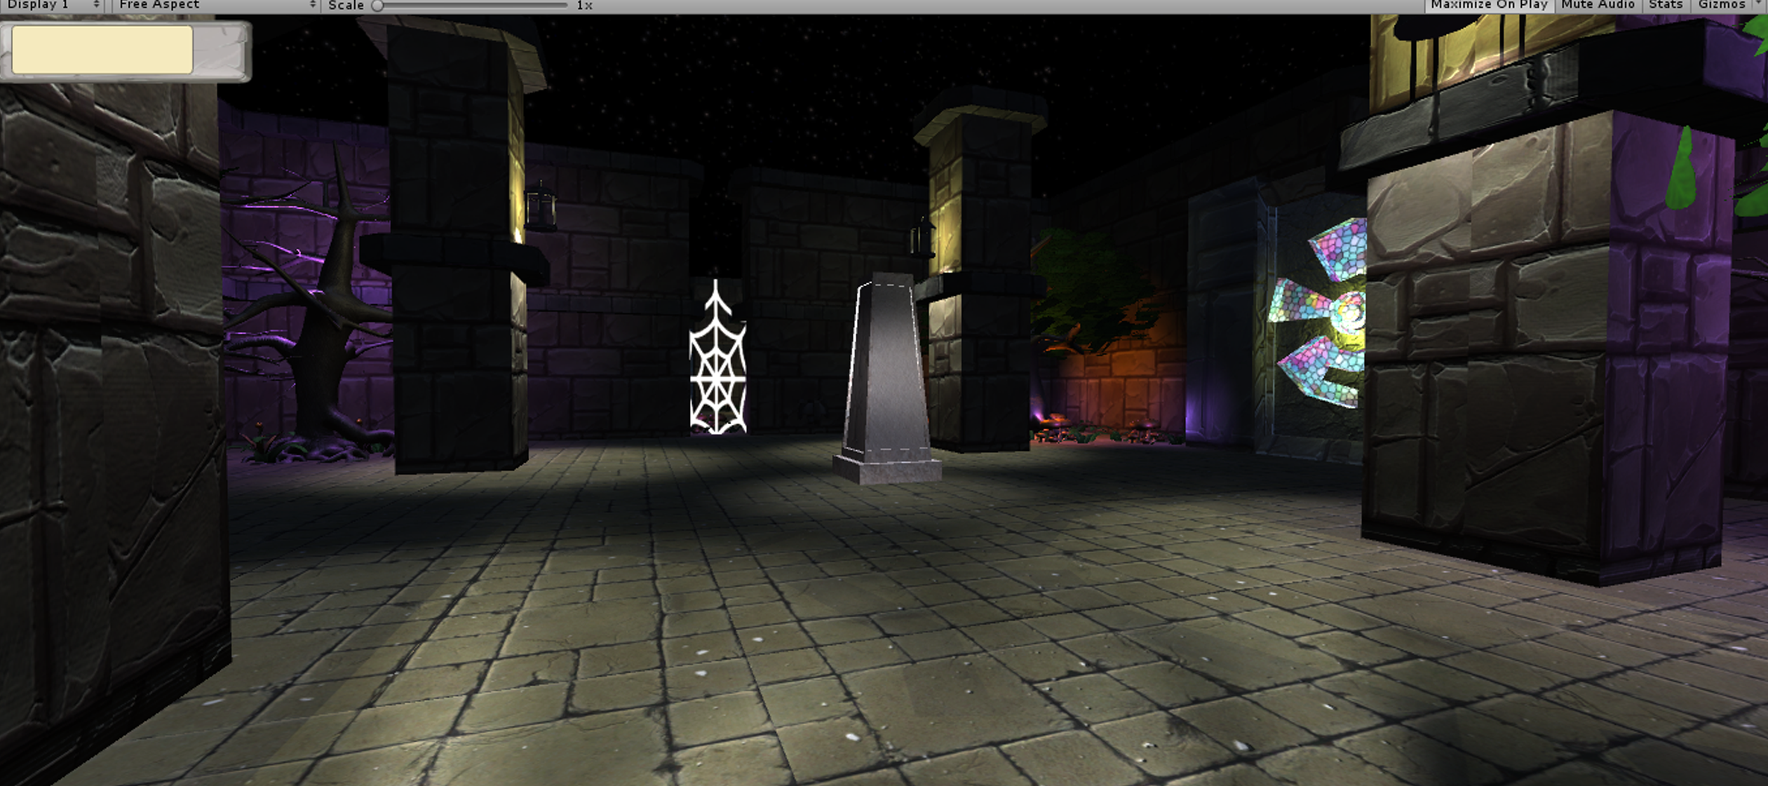
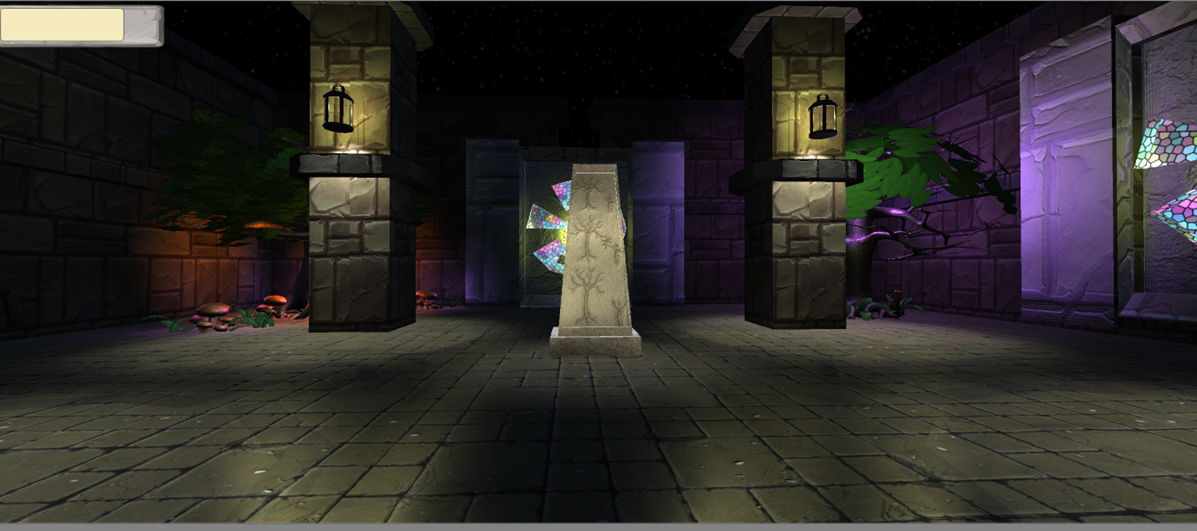
Level 01 Design
-Verticality provided by stairs.
-Architectural Weenies (Landmarks).

Slide 7
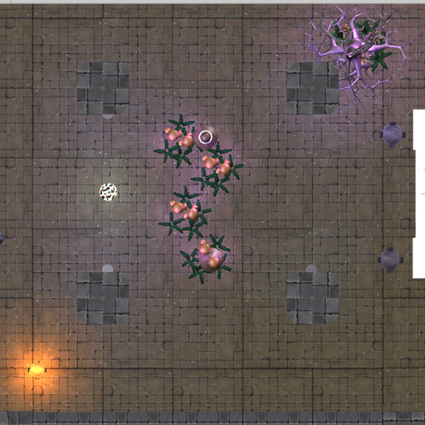
Level 01 Design
-Auto Complete puzzle
-One mirror.

Slide 8
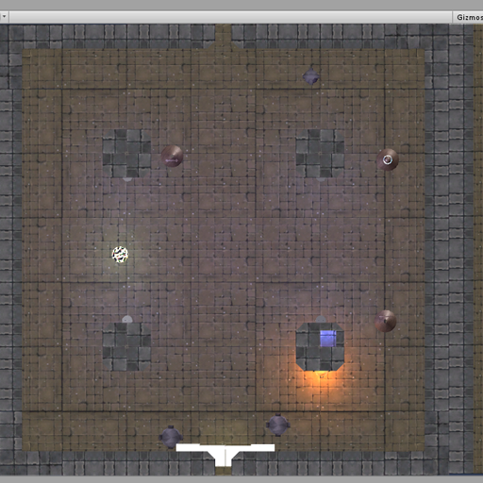
Level 01 Design
-Two mirrors
-obstructed by pillars

Slide 9
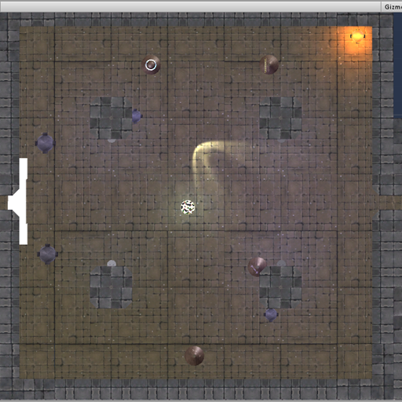
Level 01 Design

Slide 10
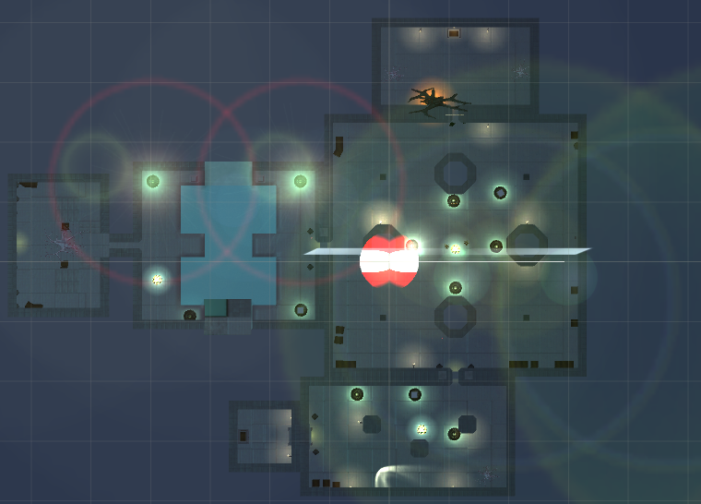
Level 02 Design
Tom :P

Slide 11
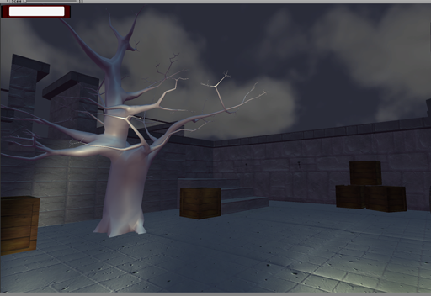
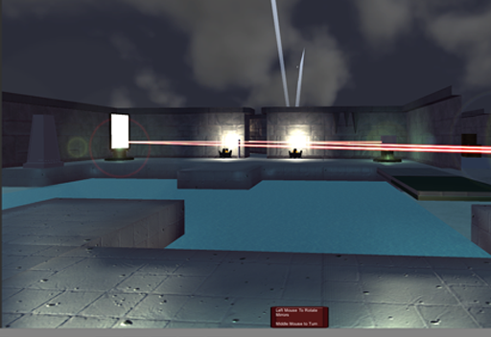
Level 02 Design
Tom :P

Slide 12
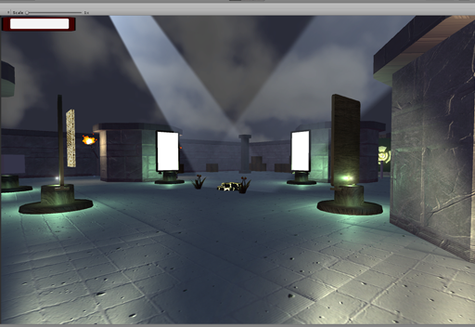
Level 02 Design
Tom :P

Slide 13
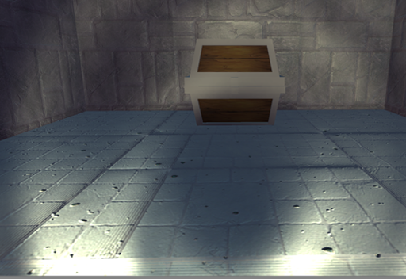
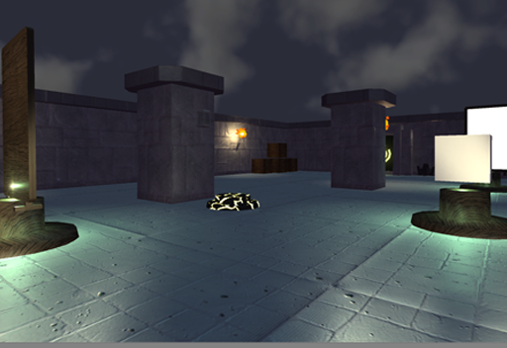
Level 02 Design
Tom :P

Slide 14
Level 03 Design
Courtney :P

Slide 15
Known Issues
Optimisation.
Player Controller (First person vs Third person).
Lighting ☹.

Slide 16
Next Steps
Playtest.
Lighting.
Visual Effects.
Audio Effects.
Menu/End screen art.

Slide 17
Any questions?

